Slide 2
Generative AI for the .NET Developer
Aaron Powell

Slide 3
Demo

Slide 4
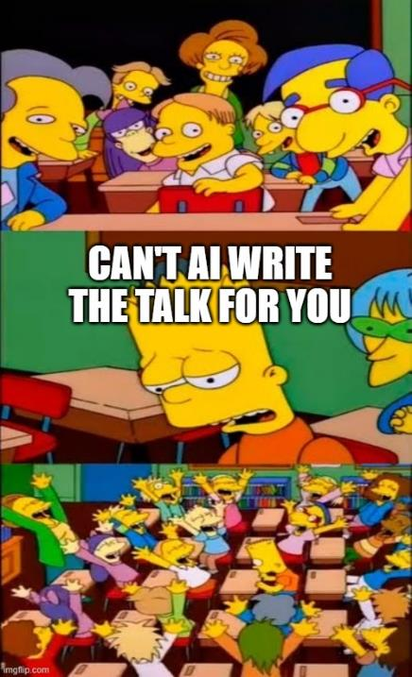

Slide 5


Slide 6
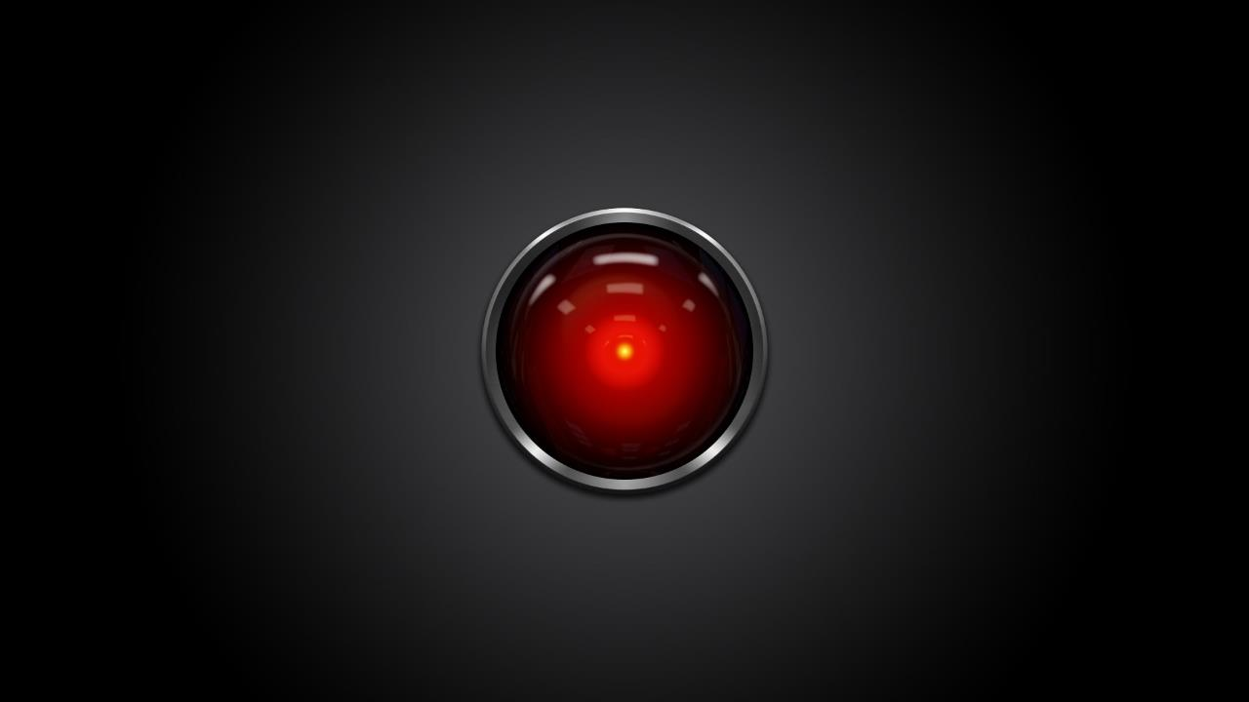
This Photo by Unknown Author is licensed under CC BY-SA-NC

Slide 7
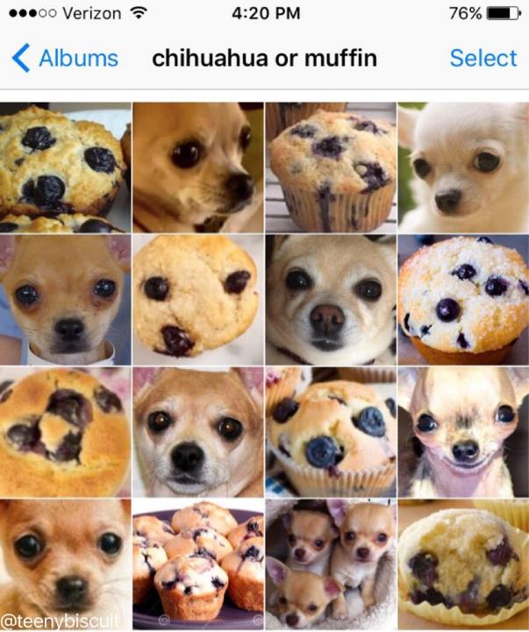
https://www.karenzack.com/work/recognition-series

Slide 8
Generative AI

Slide 9
Unprecedented Vertical growth
Time to reach 100M users
Mobile phones: 16 years
100M
1
2
3
Internet: 7 years
Facebook: 4.5 years
ChatGPT: 2 months
50M
16 years
2 months

Slide 10


Slide 11


Slide 12
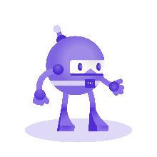


Slide 13


Ensure that artificial general intelligence (AGI) benefits humanity
Empower every person and organization on the planet to achieve more

Slide 14
Azure OpenAI Service
Large pretrained foundation AI models custom-tunable with your parameters and your data

Slide 15
Demo

Slide 16
In Closing
AI means a lot, but right now it’s mostly Generative AI
Azure OpenAI Service for GPT models
https://github.com/aaronpowell/ConsoleGPT
Getting started is a HTTP call away

Slide 17


Slide 18
Thank you
Aaron Powell
Principal Cloud Advocate
aaron.powell@microsoft.com
www.aaron-powell.com

Slide 19
Download .NET 8
https://aka.ms/get-dotnet-8

